Slide 1
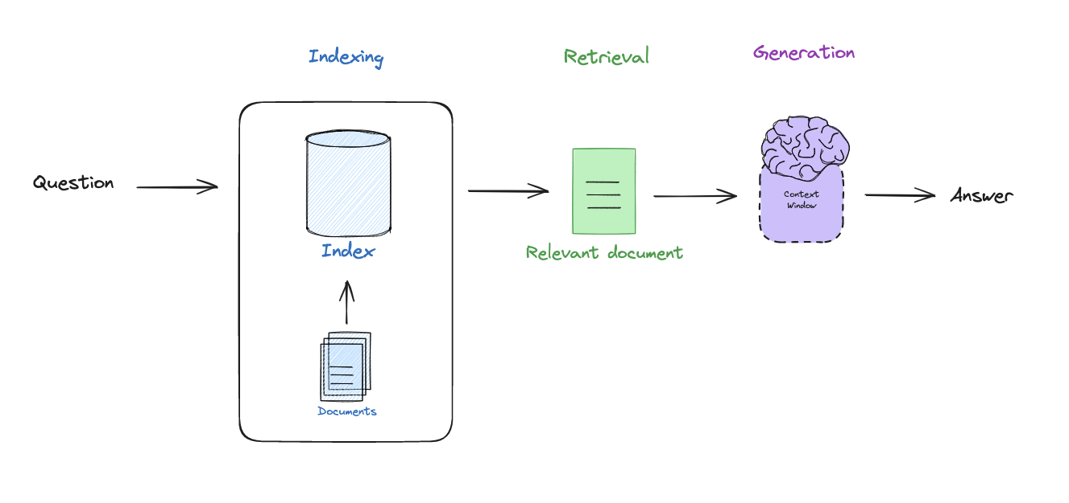
Retrieval Augmented Generation
Notes:
RAG is a general methodology to connect LLMs to external data, using (1) indexing (make external data retrievable), (2) retrieval (fetch external data that is relevant to a query that we want the LLM to reason about, (3) generation pass this to an LLM to generate an answer.

Slide 2
Outline
Basics
Indexing
Retrieval
Generation
Advanced
Query transformations
Routing
Query construction
Indexing
Retrieval
Generation

Slide 3
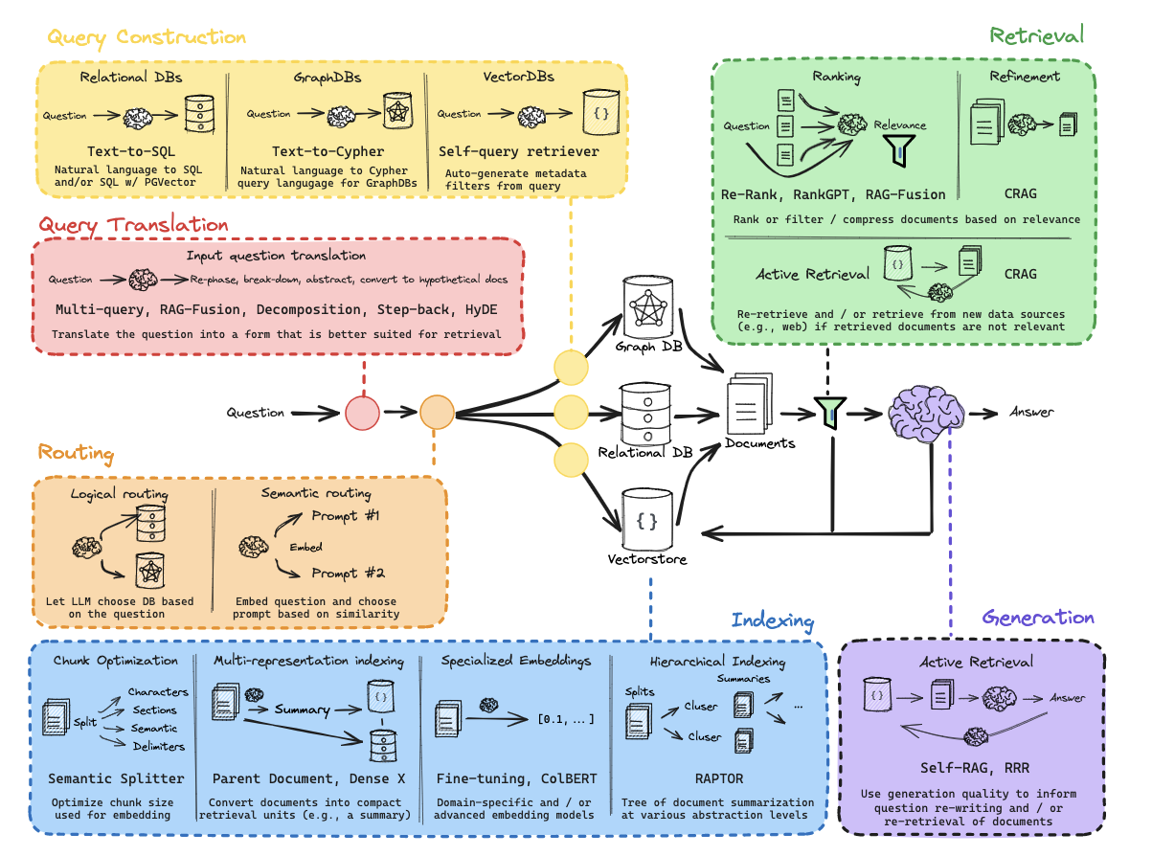

Slide 4
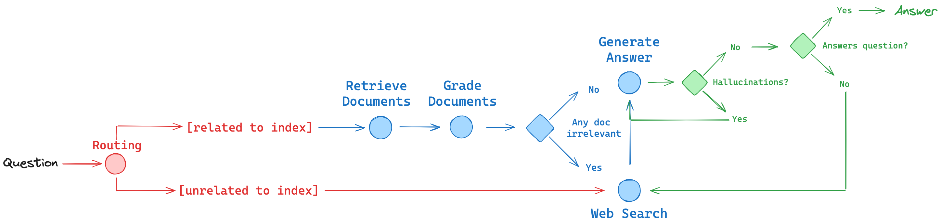
Local RAG agent with LLaMA3

Slide 5
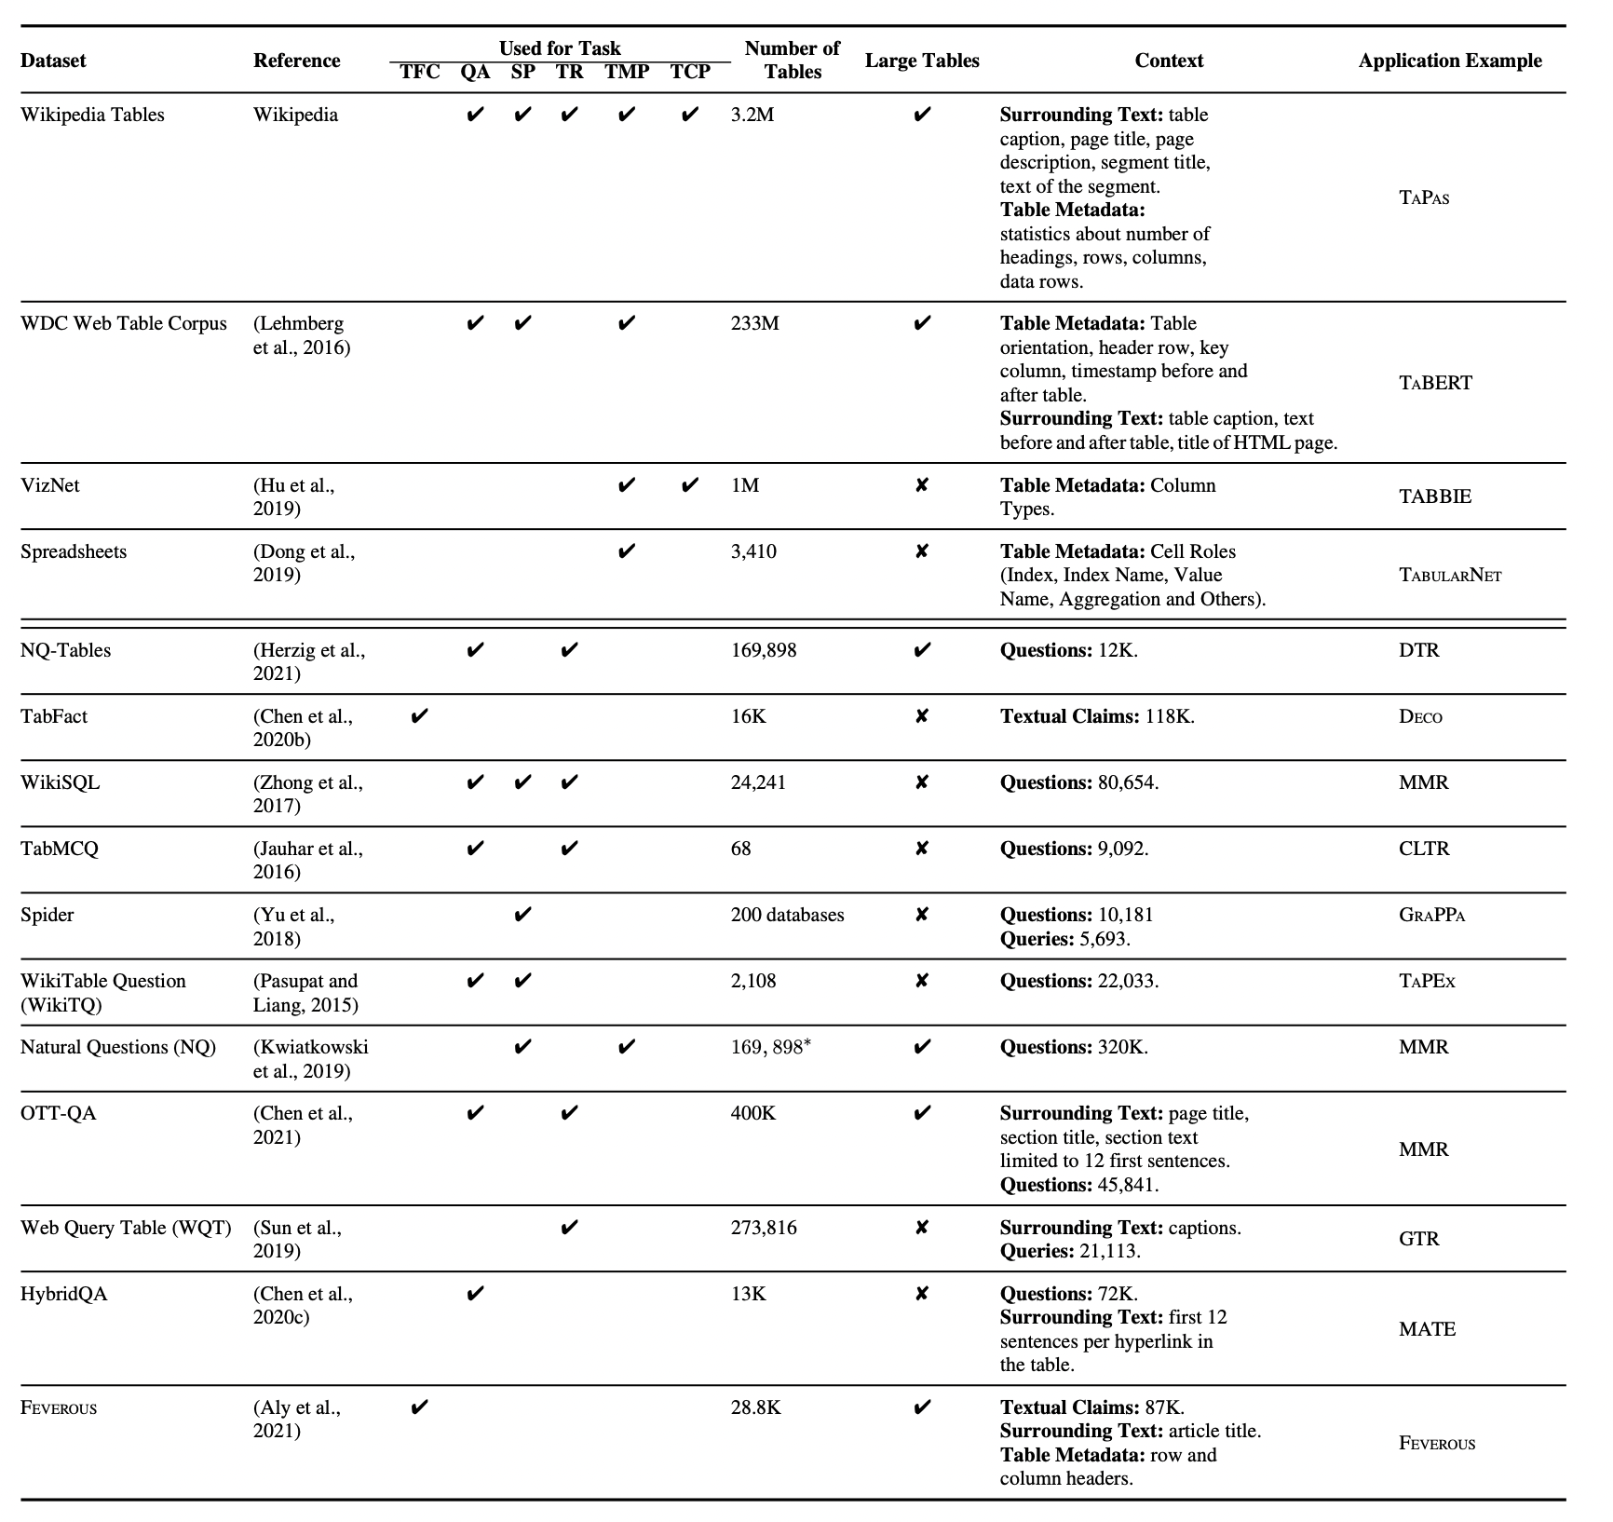

Slide 6
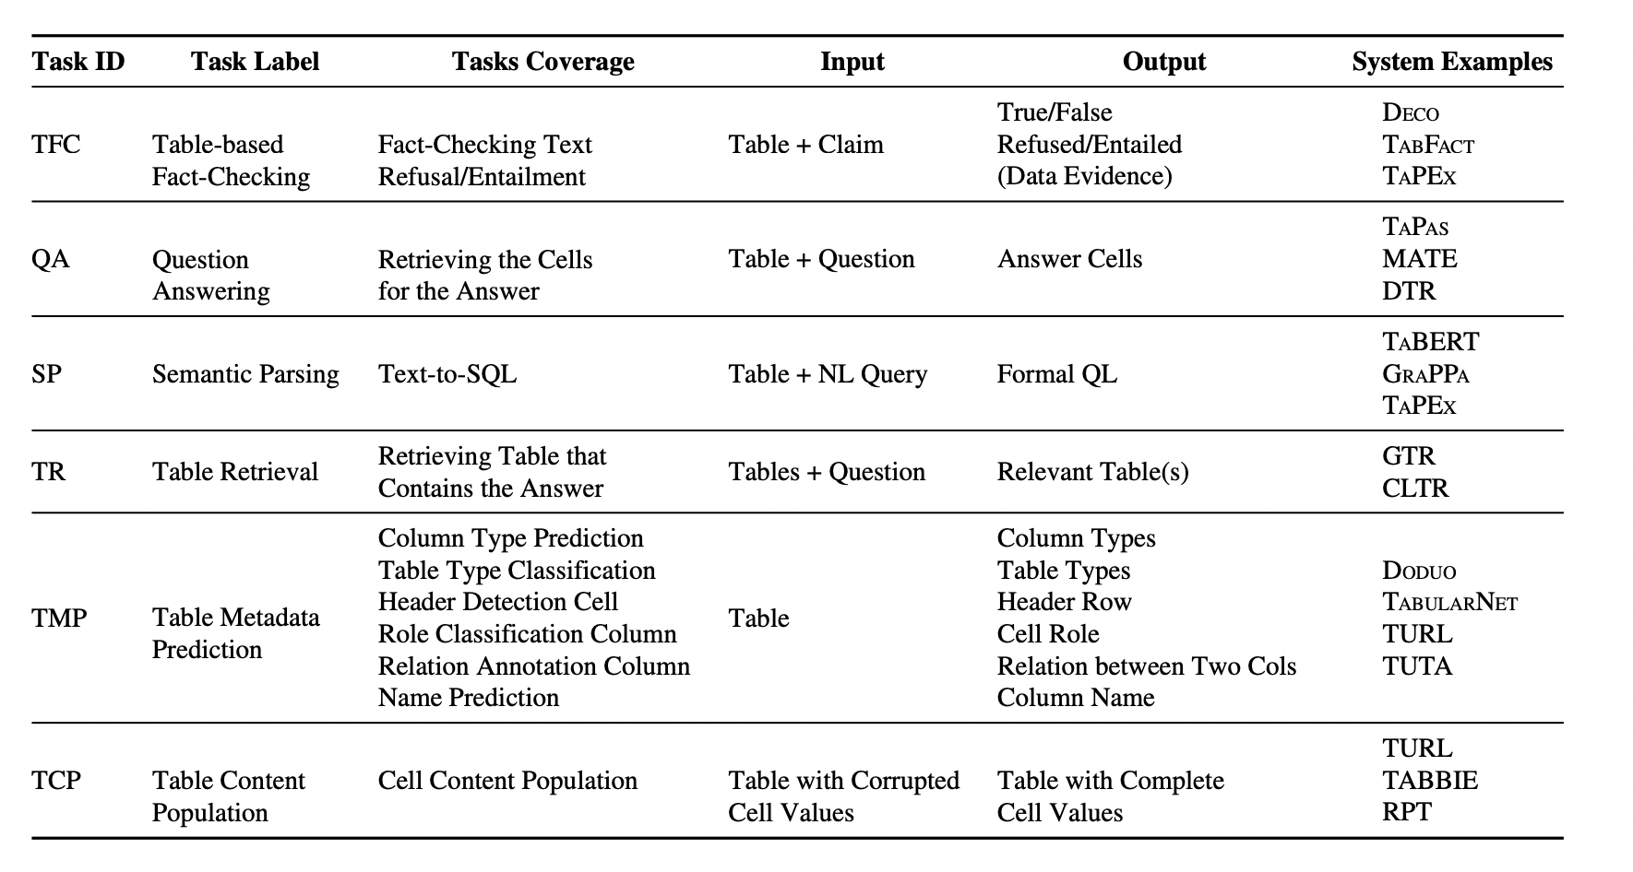
Large Language Models(LLMs) on Tabular Data: Prediction, Generation, and Understanding - A Survey

Slide 7
DB
Data base 中不同数据存在？
各种method转化方式的效率

Slide 8
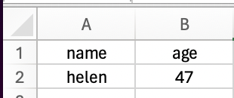
Serialization
Most common method is Markdown
T ∗ = [HEAD], c1, · · ·, cN , [ROW], 1, r1, [ROW], 2, r2, · · ·, rM

Slide 9
Serialization
DFLoader and JSON formats are better for fact-finding and table transformation tasks
HTML or XML table formats are better understood by GPT models over tabular QA and FV tasks
Markup languages, specifically HTML, outperformed X-separated formats for GPT3.5 and GPT4.
Notes:
1.Tabular Representation, Noisy Operators, and Impacts on Table Structure Understanding Tasks in LLMs
2. Table Meets LLM: Can Large Language Models Understand Structured Table Data? A Benchmark and Empirical Study
3. Gpt4table: Can large language models understand structured table data? a benchmark and empirical study
the GPT models were trained on a significant amount of web data and thus, probably exposed the LLMs to more HTML and XML formats when interpreting tables.

Slide 10
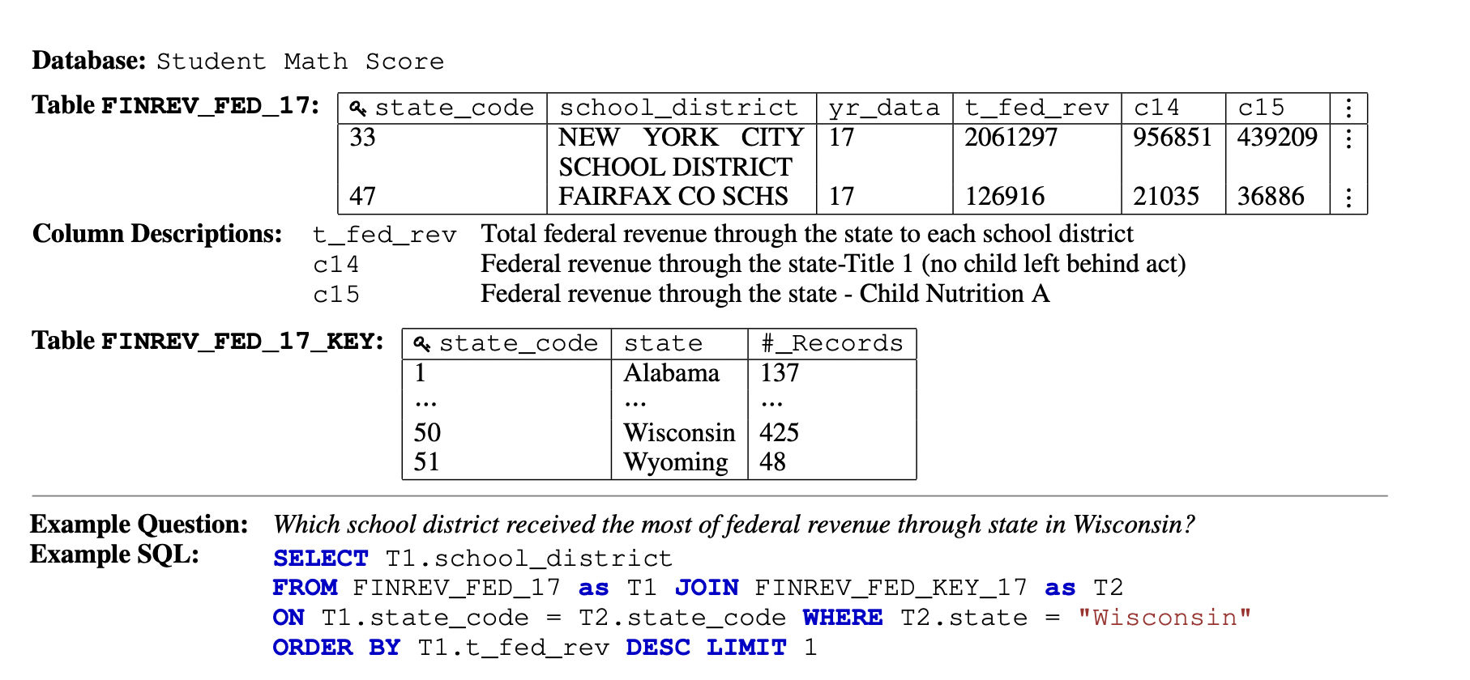
Schema linking
KaggleDBQA: Realistic Evaluation of Text-to-SQL Parsers
Notes:
Dataset

Slide 11
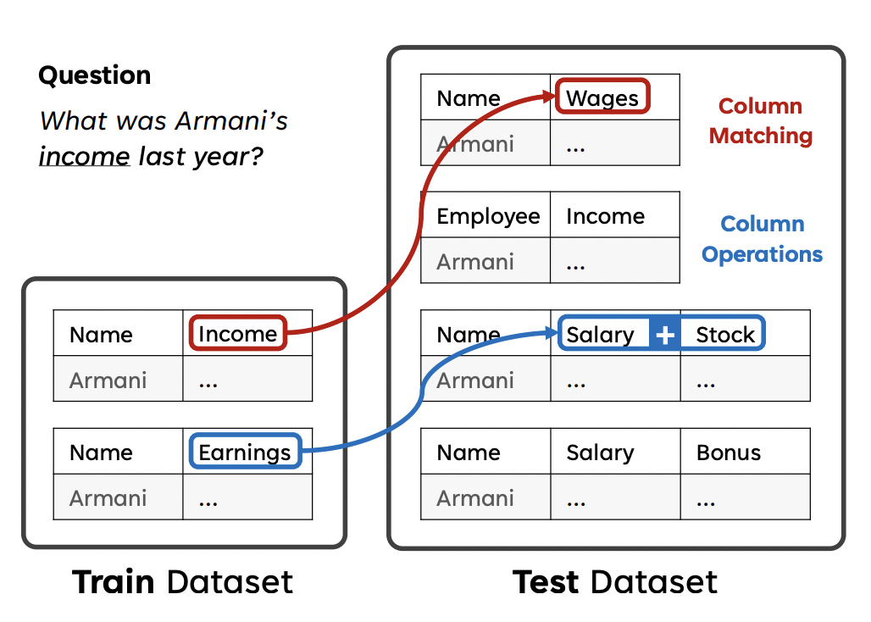
Schema linking
Bridging the Generalization Gap in Text-to-SQL Parsing with Schema Expansion
Notes:
Dataset
finance, sports, and science.

Slide 12
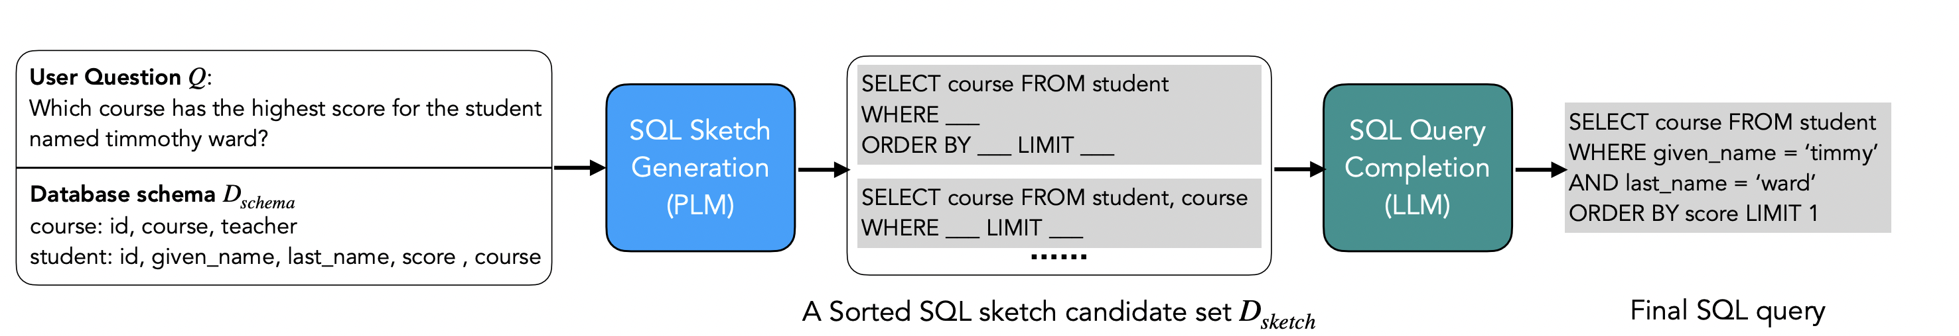
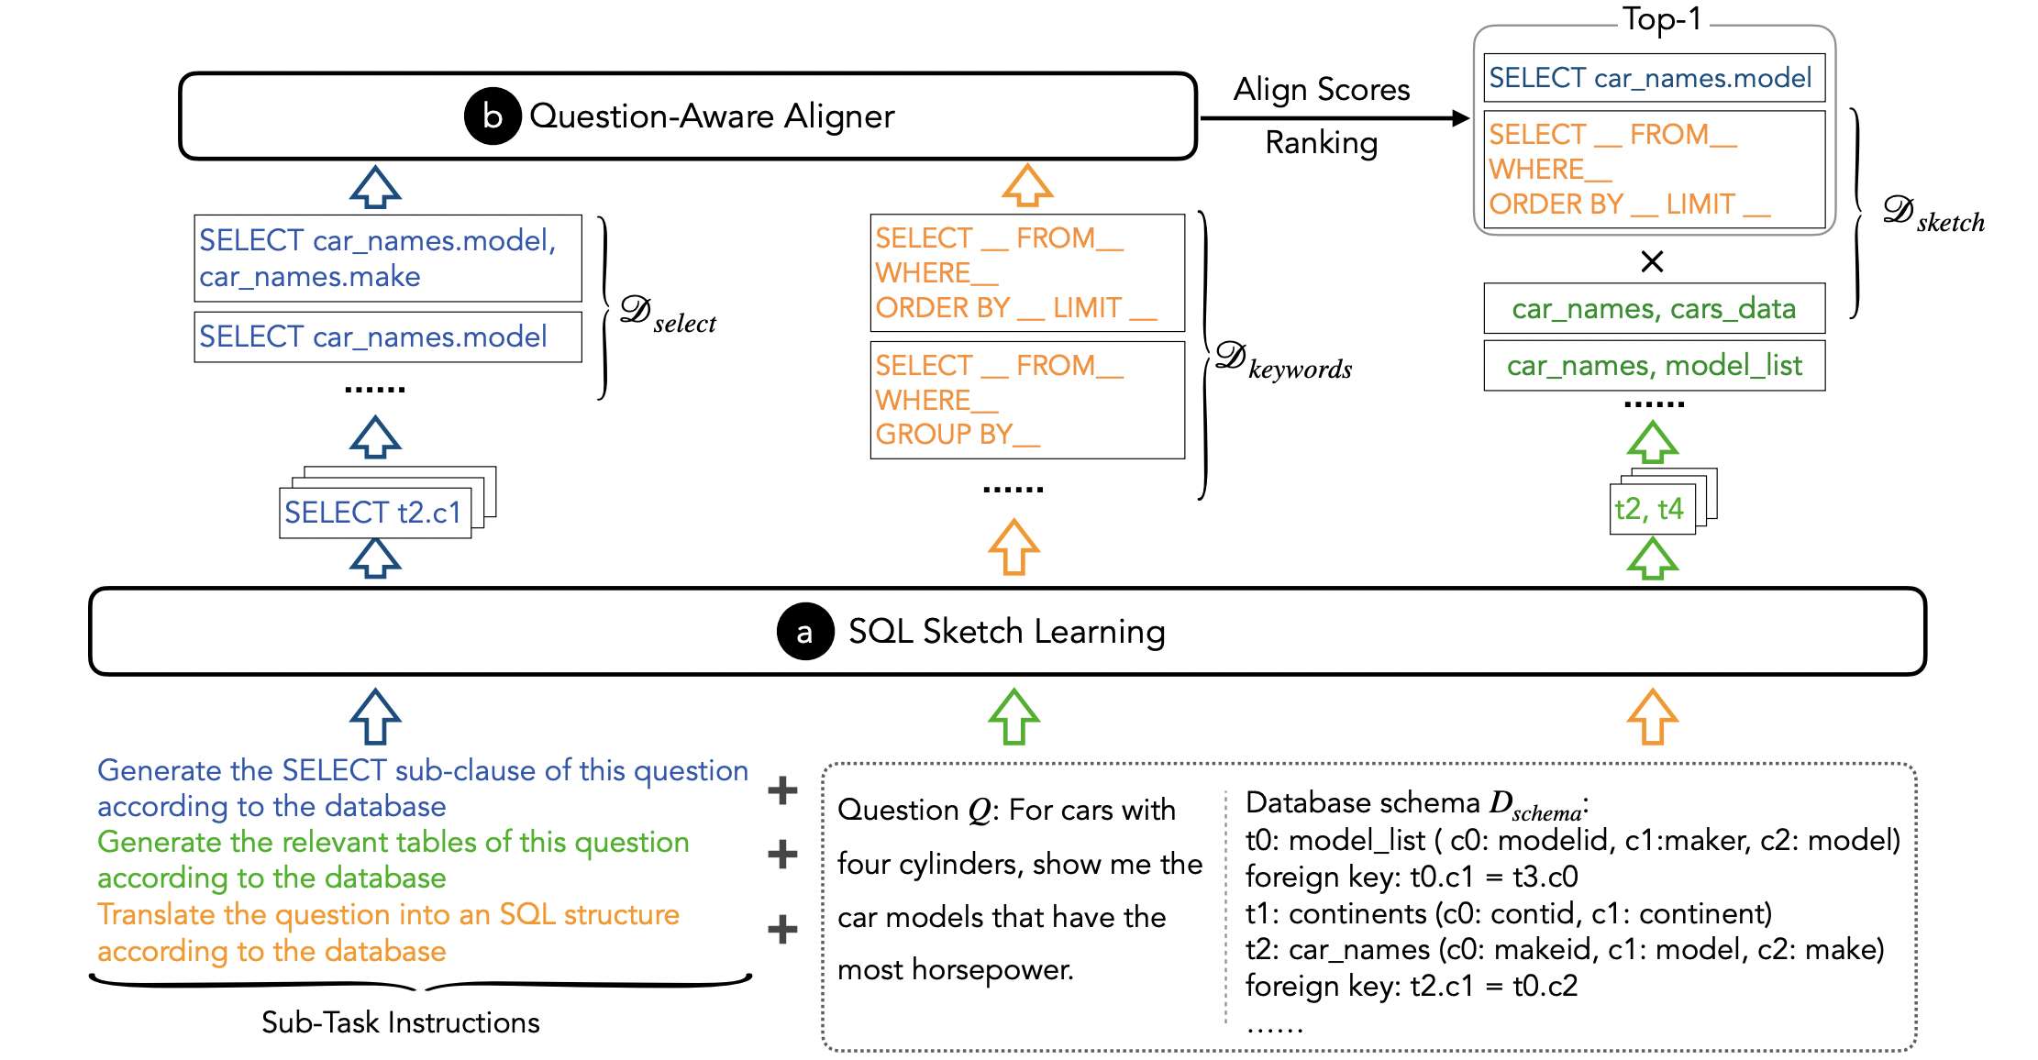
Schema linking
Interleaving Pre-Trained Language Models and Large Language Models for Zero-Shot NL2SQL Generation
Notes:
Framework

Slide 13
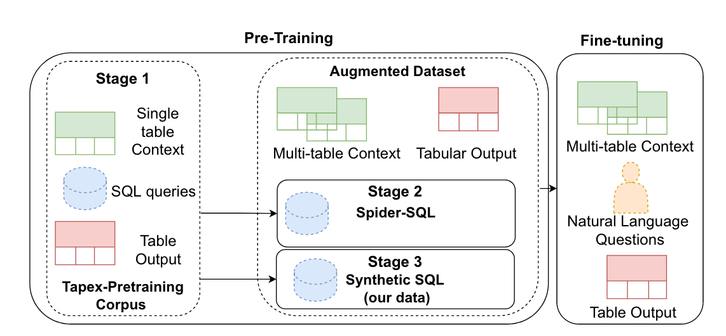
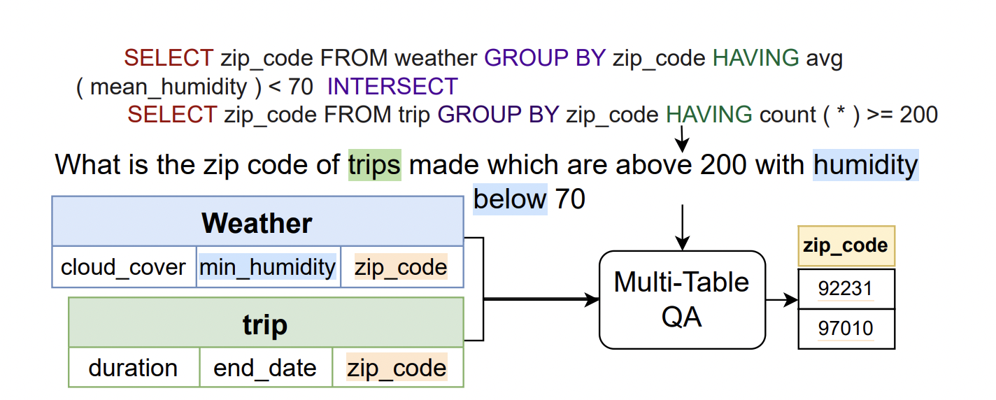
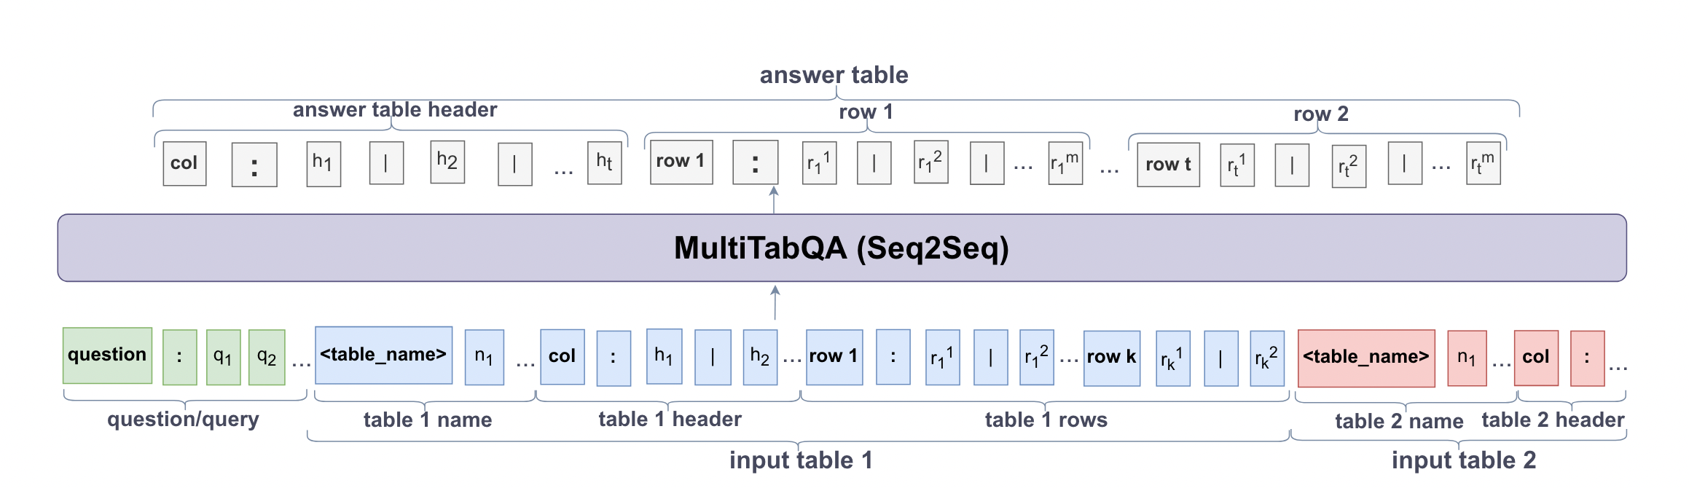
Schema linking
MultiTabQA: Generating Tabular Answers for Multi-Table Question Answering
Notes:
Model input/output:
The input to the model is a sequence comprised of the query or the natural language question, followed by a sequence of input tables, represented by the table name and the corresponding flattened table.
The output of the model is also a flattened table in row-major format, but without a table name.
Multi-table QA dataset

Slide 14
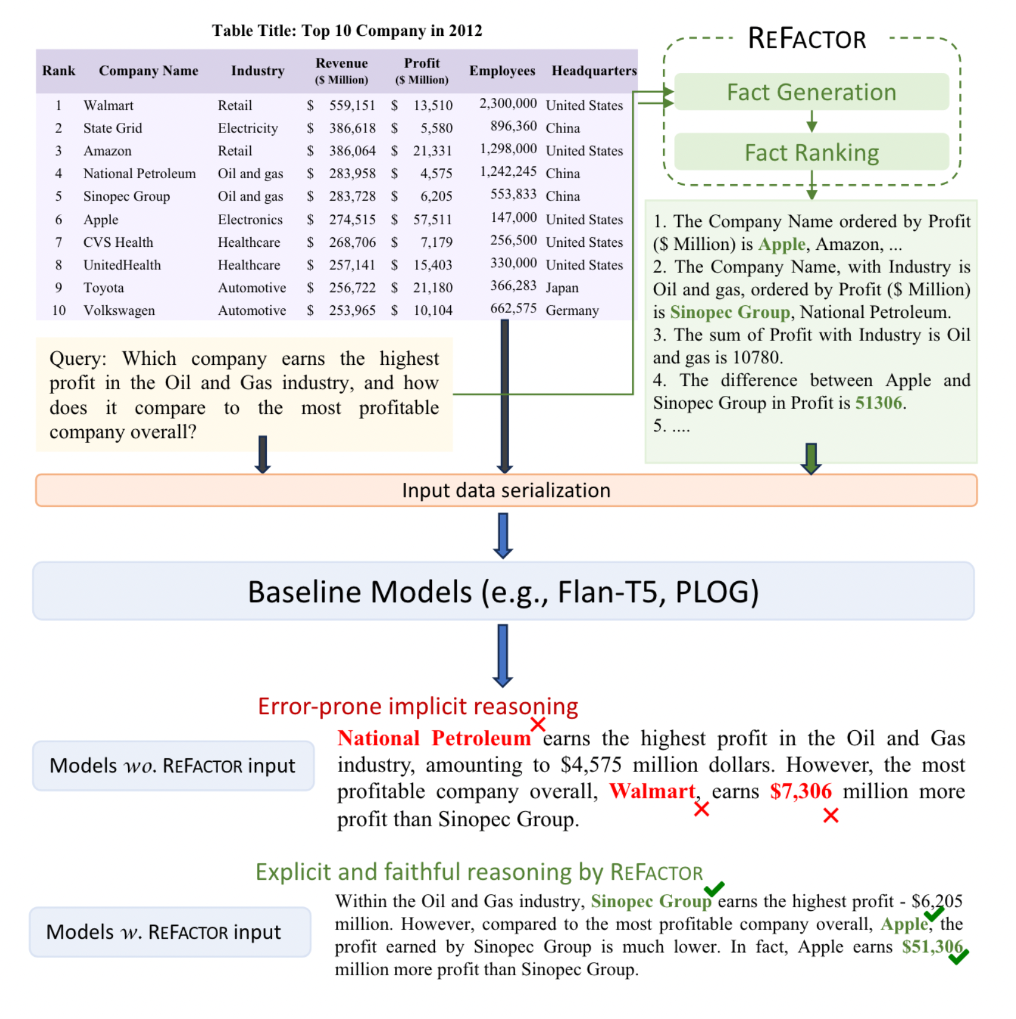
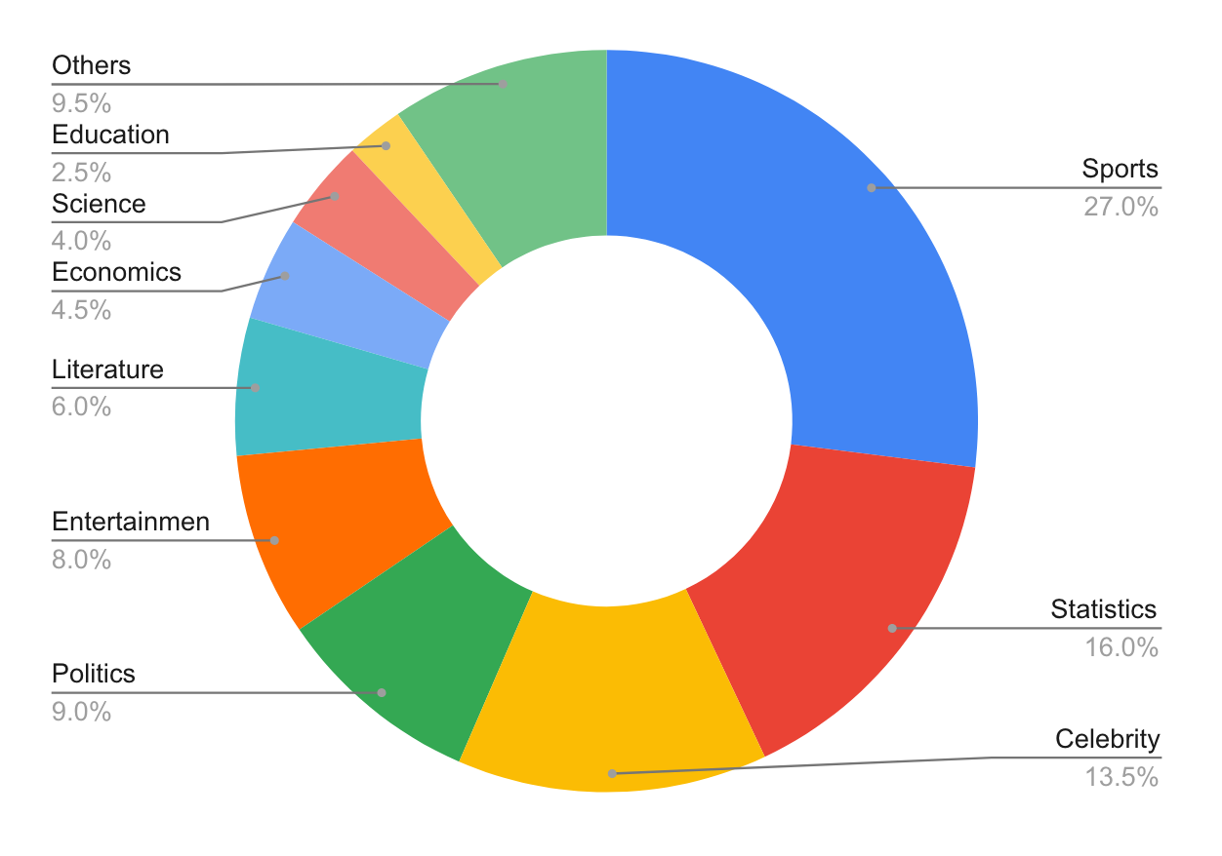
Schema linking
QTSUMM: Query-Focused Summarization over Tabular Data

Slide 15
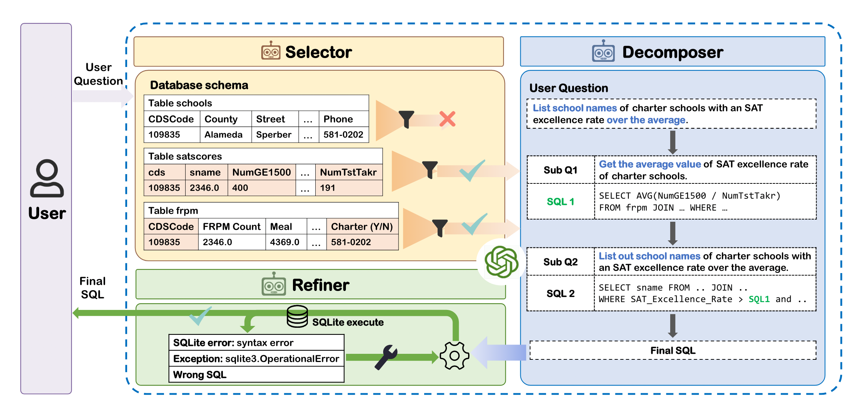
Schema linking
MAC-SQL: A Multi-Agent Collaborative Framework for Text-to-SQL

Slide 16
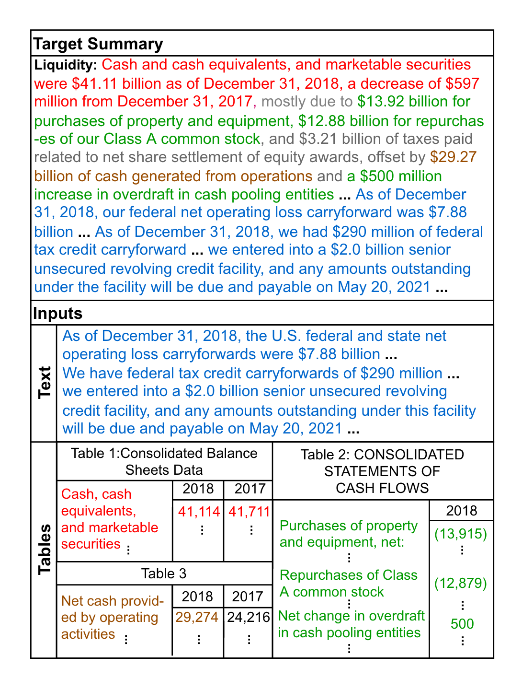
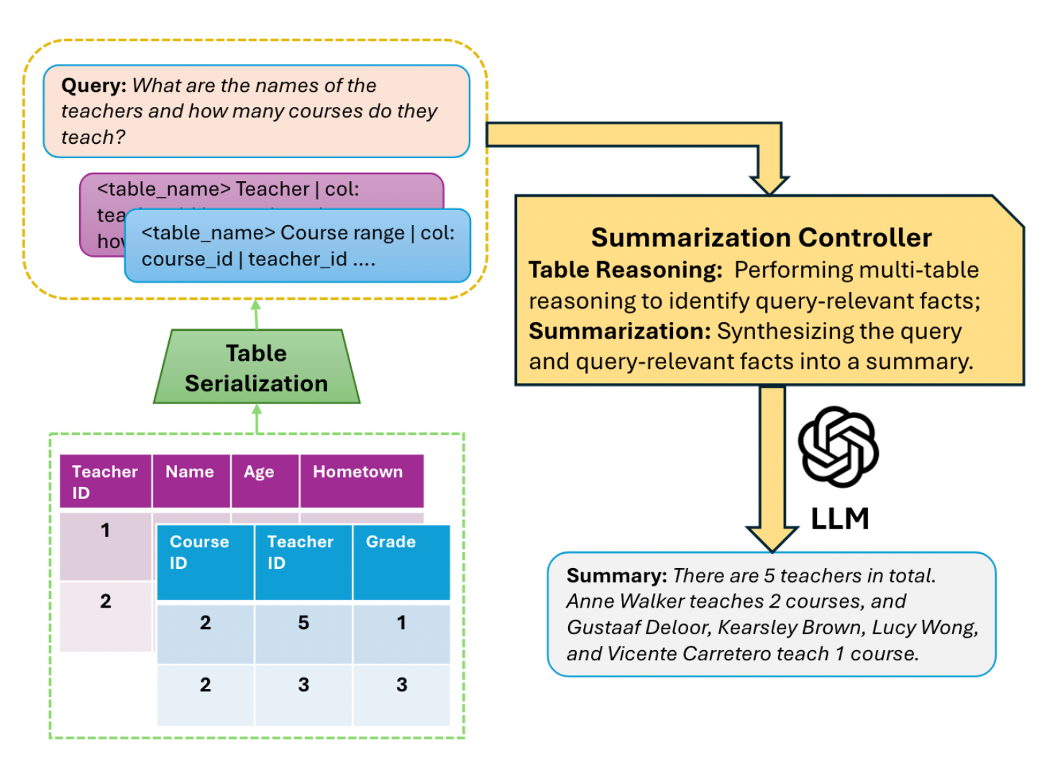
Schema linking
QFMTS: Generating Query-Focused Summaries over Multi-Table Inputs
Long Text and Multi-Table Summarization: Dataset and Method

Slide 17
Text-to-SQL (Dataset)
KaggleDBQA
GitHub - Chia-Hsuan-Lee/KaggleDBQA: Introduction page of a challenging text-to-SQL dataset: KaggleDBQA
Tapilot-Crossing
Tapilot-Crossing: Benchmarking and Evolving LLMs Towards Interactive Data Analysis Agents
Bird
BIRD-bench
Spider
Spider: Yale Semantic Parsing and Text-to-SQL Challenge (yale-lily.github.io)
gretelai/synthetic_text_to_sql
gretelai/synthetic_text_to_sql · Datasets at Hugging Face
b-mc2/sql-create-context
b-mc2/sql-create-context · Datasets at Hugging Face
WikiSQL
GitHub - salesforce/WikiSQL: A large annotated semantic parsing corpus for developing natural language interfaces.
Awesome Text2SQL
GitHub - eosphoros-ai/Awesome-Text2SQL: Curated tutorials and resources for Large Language Models, Text2SQL, Text2DSL、Text2API、Text2Vis and more.
ODIS-Text-to-SQL
GitHub - shuaichenchang/ODIS-Text-to-SQL
Text2SQL-NLVariation
Text2SQL-NLVariation/RESDSQL at main · saparina/Text2SQL-NLVariation · GitHub
diagnostic-robustness-text-to-sql （adversarial training）
GitHub - awslabs/diagnostic-robustness-text-to-sql: Data for paper "Dr.Spider: A Diagnostic Evaluation Benchmark towards Text-to-SQL Robustness"

Slide 18
Text-to-SQL (Model)
defog/llama-3-sqlcoder-8b
defog/llama-3-sqlcoder-8b · Hugging Face
Granite Code
Granite Code Models - a ibm-granite Collection (huggingface.co)
RESDSQL
GitHub - RUCKBReasoning/RESDSQL: The Pytorch implementation of RESDSQL (AAAI 2023).
QTSumm: Query-Focused Summarization over Tabular Data
GitHub - yale-nlp/QTSumm: Data and Code for EMNLP 2023 paper "QTSumm: Query-Focused Summarization over Tabular Data”
TAPEX: Table Pre-training via Learning a Neural SQL Executor
GitHub - microsoft/Table-Pretraining: ICLR 2022 Paper, SOTA Table Pre-training Model, TAPEX: Table Pre-training via Learning a Neural SQL Executor

Slide 19
Text-to-SQL (Metrics)
Exact match accuracy (EM)
Execution accuracy (EX)
Valid efficiency score (VES)

Slide 20
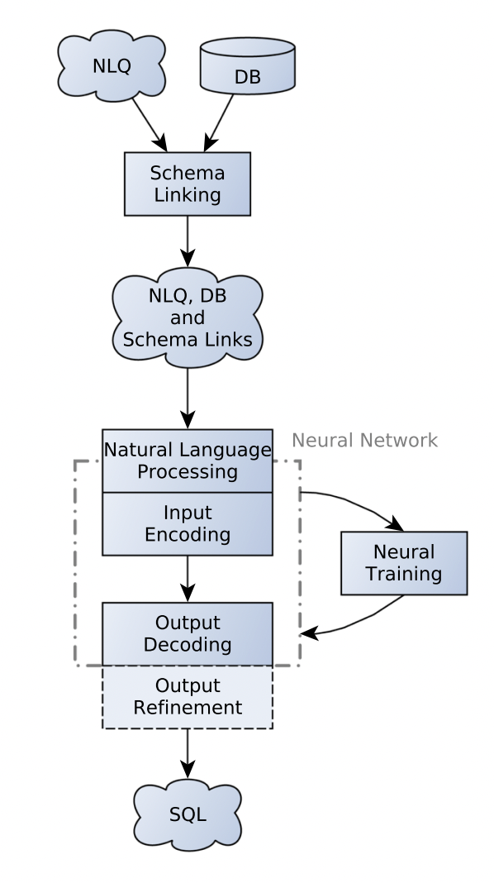
Overview of a neural Text-to-SQL system

Slide 21


Multi-agent framework？
Format
Query translation/construction
Text to Sql
Generation
Signal table
User question
Discriminator
Multi tables
Generation

Slide 22
Databases
Relational databases
In a relational database data is organized into tables that hold information about each entity and represent pre-defined categories through rows and columns. This structured data is both efficient and flexible to access. Example: SQL Server, Azure SQL, MySQL, PostgreSQL, and MariaDB.
Non-relational databases
Non-relational databases, store unstructured or semi-structured data. They use a storage model that's optimized for the specific requirements of the type of data being stored. Non-relational databases allow for larger sets of distributed data to be accessed, updated, and analyzed quickly. Example: MongoDB, Azure Cosmos DB, DocumentDB, Cassandra, Couchbase, HBase, Redis, and Neo4j.
In-memory databases and caches
In-memory databases are commonly used to store copies of frequently accessed information like pricing or inventory data. This is known as caching. When you cache data, you store a copy of it in a temporary location so that it loads faster the next time it's requested

Slide 23
Relational databases

Slide 24
Non-relational databases
MongoDB (JSON)
{ "user_id": "12345", "name": "John Doe", "email": "johndoe@example.com", "preferences": { "language": "en", "notifications": true }, "orders": [ { "order_id": "789", "product": "Laptop", "quantity": 1, "price": 999.99 }, { "order_id": "790", "product": "Mouse", "quantity": 2, "price": 25.00 } ] }

Slide 25
Non-relational databases
Cassandra (Column-family storage)
RowKey ColumnFamily:Column Value user123 info:name Alice user123 info:email alice@example.com user123 preferences:language en user123 preferences:notifications true
Redis (Key-value pairs)
SET user:1000:name "Alice" SET user:1000:email "alice@example.com" HSET user:1000:preferences language "en" HSET user:1000:preferences notifications true

Slide 26
Non-relational databases
Neo4j (Graph database)
CREATE (user:User {user_id: '12345', name: 'Bob Smith', email: 'bobsmith@example.com'}) CREATE (product1:Product {product_id: '1', name: 'Tablet'}) CREATE (product2:Product {product_id: '2', name: 'Smartphone'}) CREATE (user)-[:PURCHASED]->(product1) CREATE (user)-[:PURCHASED]->(product2)

Slide 27
Non-relational databases
HBase (Column-family store)
RowKey ColumnFamily:Column Value user123 info:name Alice user123 info:email alice@example.com user123 preferences:language en user123 preferences:notifications true

Slide 28
Semantic Detection and Comparison(Table Content)
Semantic Similarity
Cosine, Distance, Jaccard Coefficient, Pearson Correlation Coefficient …
GitHub - Sakil786/sentence_similarity_semantic_search: sentence_similarity_semantic_search

Slide 29
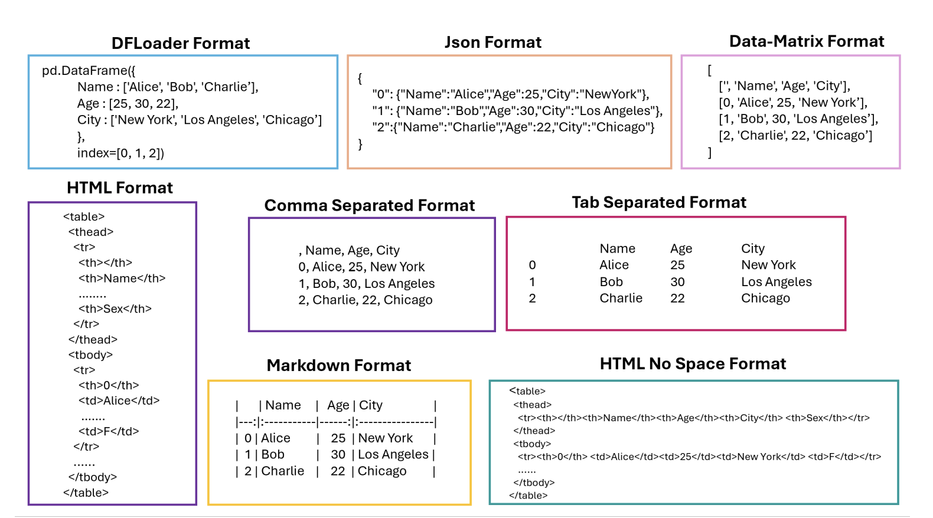
Semantic Detection and Comparison(Table Content)
Training the LLM and evaluating its performance
Notes:
Tabular Representation, Noisy Operators, and Impacts on Table Structure Understanding Tasks in LLMs

Slide 30
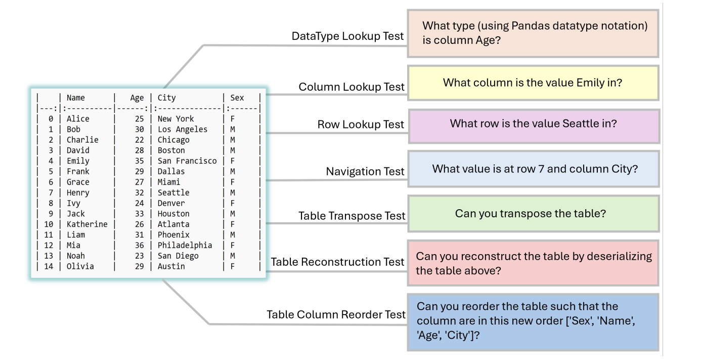
Semantic Detection and Comparison(Table Content)
Training the LLM and evaluating its performance
Notes:
Tabular Representation, Noisy Operators, and Impacts on Table Structure Understanding Tasks in LLMs

Slide 31
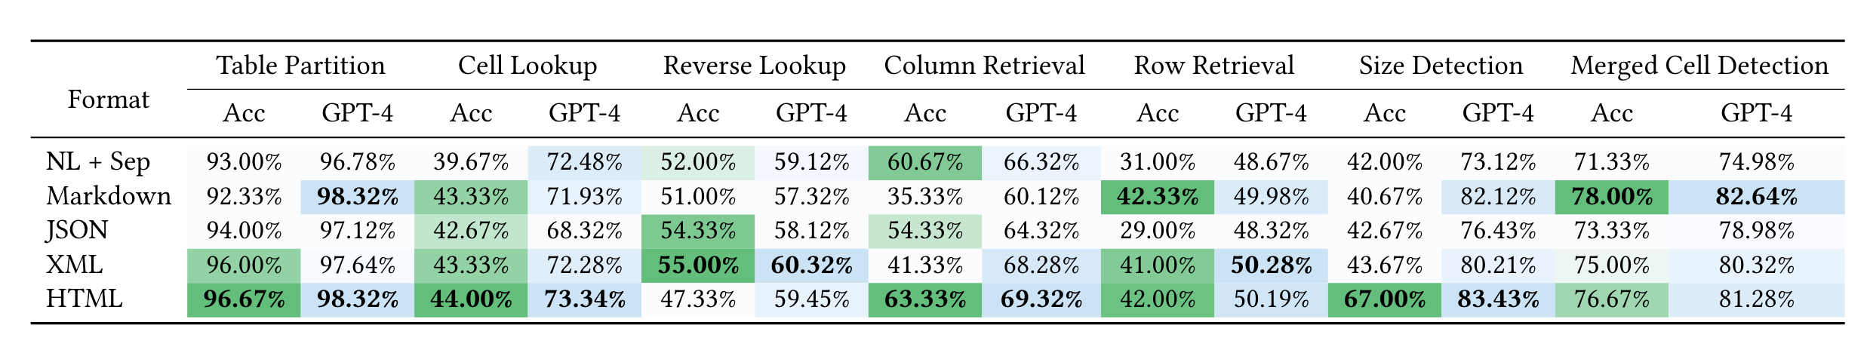
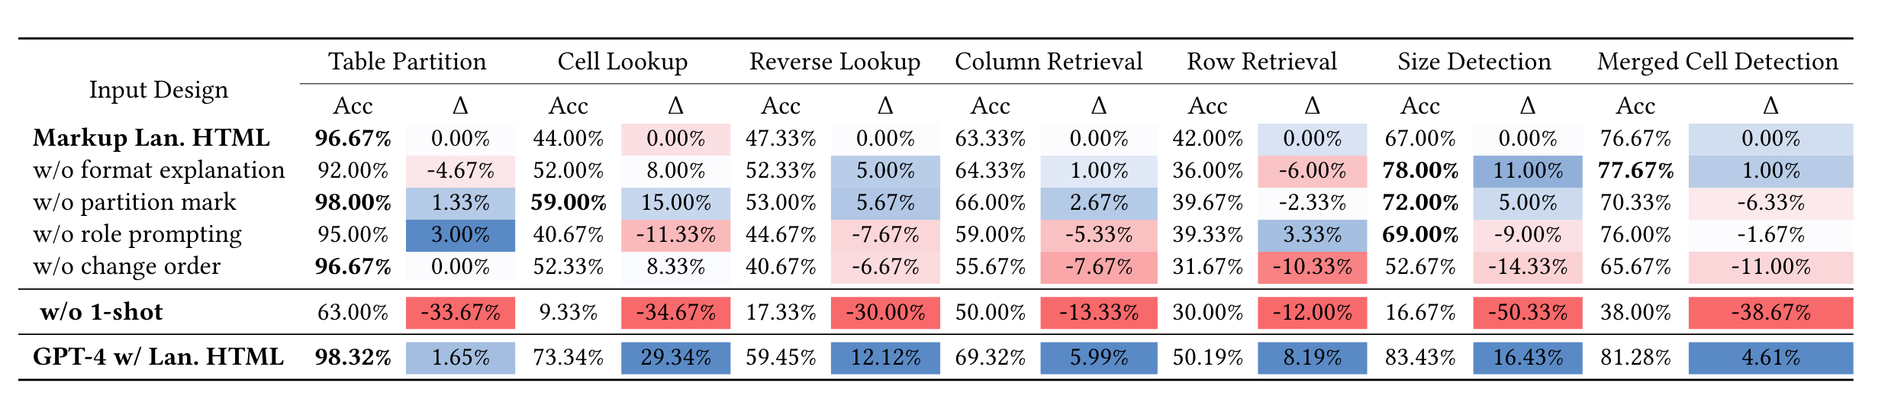
Semantic Detection and Comparison(Table Content)
Training the LLM and evaluating its performance
Notes:
GPT4Table: Can Large Language Models Understand Structured Table Data? A Benchmark and Empirical Study

Slide 32
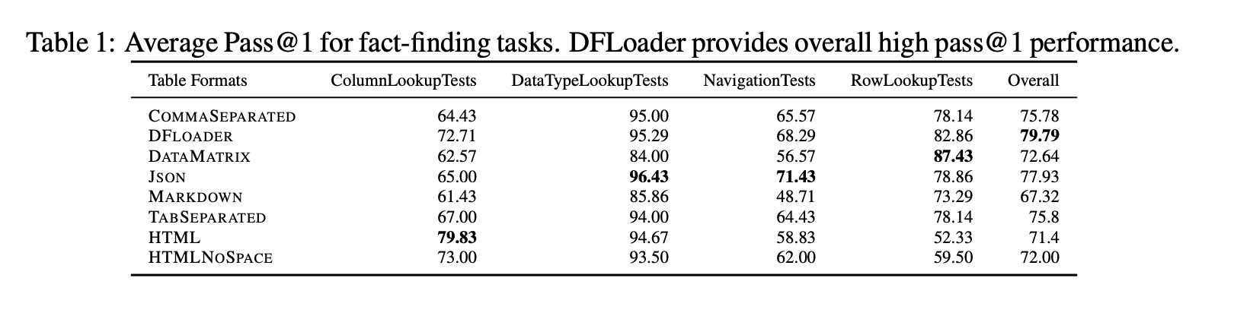
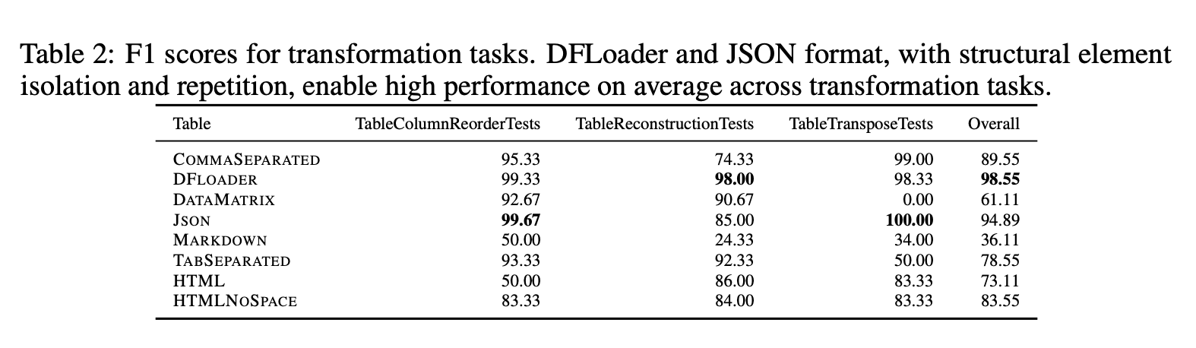
Semantic Detection and Comparison(Table Content)
Training the LLM and evaluating its performance
Notes:
Tabular Representation, Noisy Operators, and Impacts on Table Structure Understanding Tasks in LLMs

Slide 33
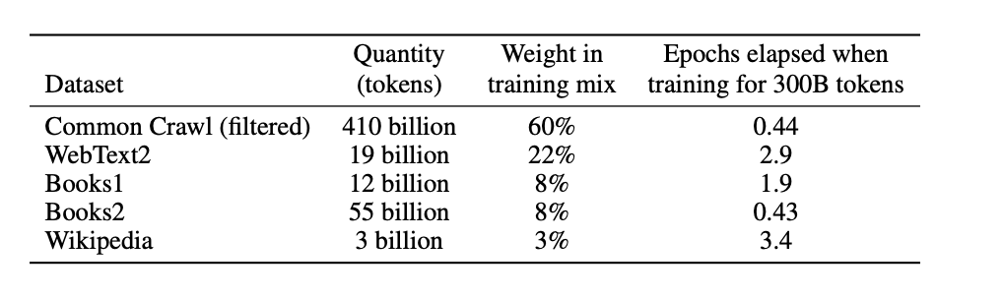
Semantic Detection and Comparison(Table Content)
GPT3.5(text-davinci-003 )
HTML, DF
Training data structure / Model architecture

Slide 34
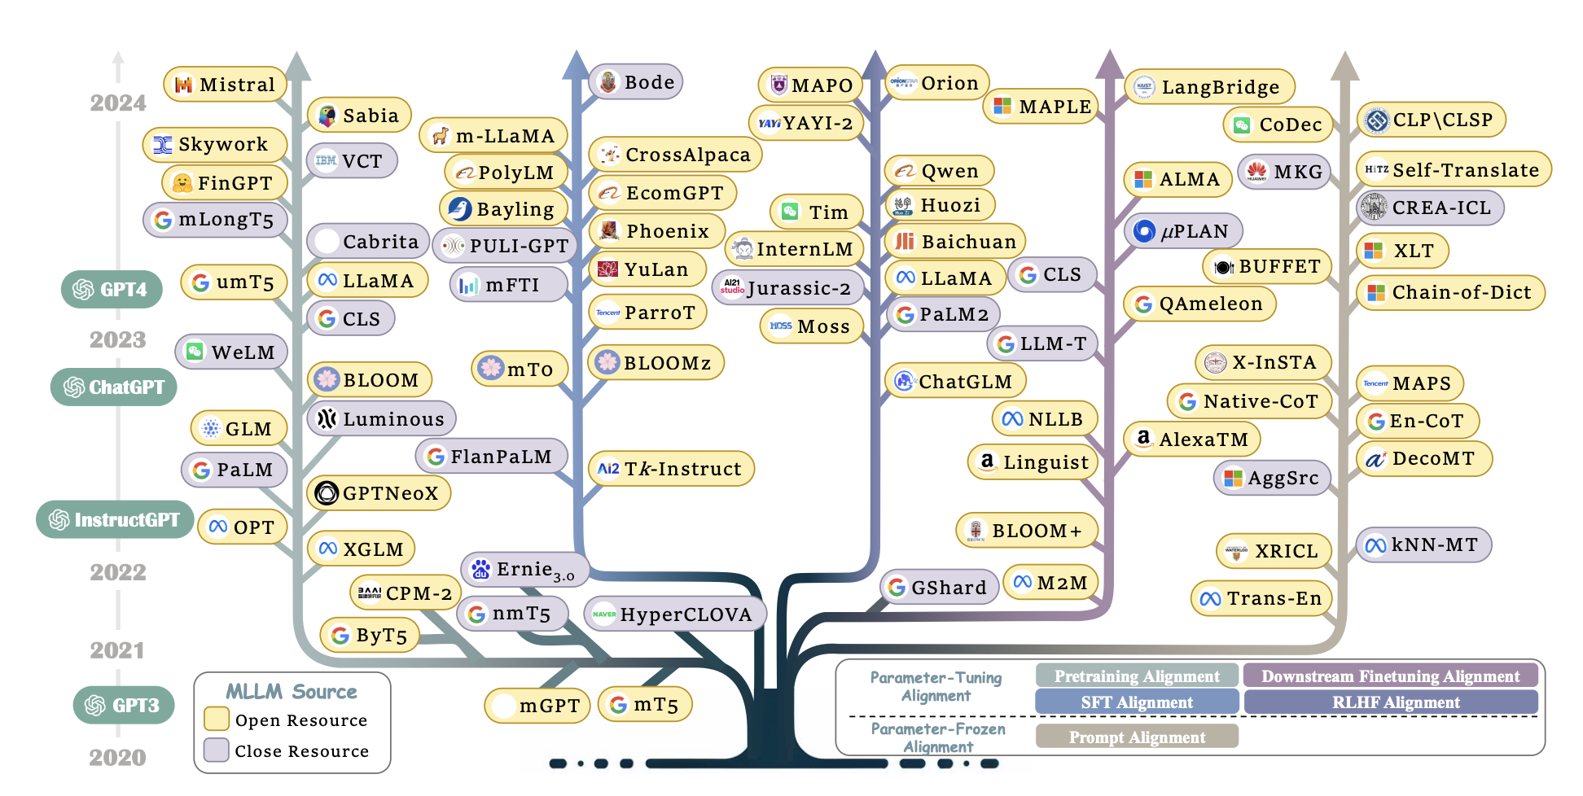
Semantic Detection and Comparison(Table Content)

Slide 35
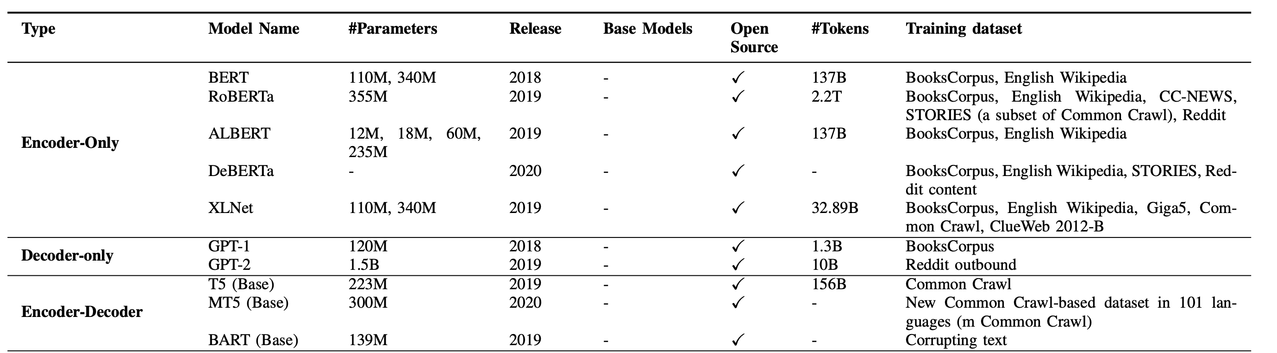
Semantic Detection and Comparison(Table Content)

Slide 36
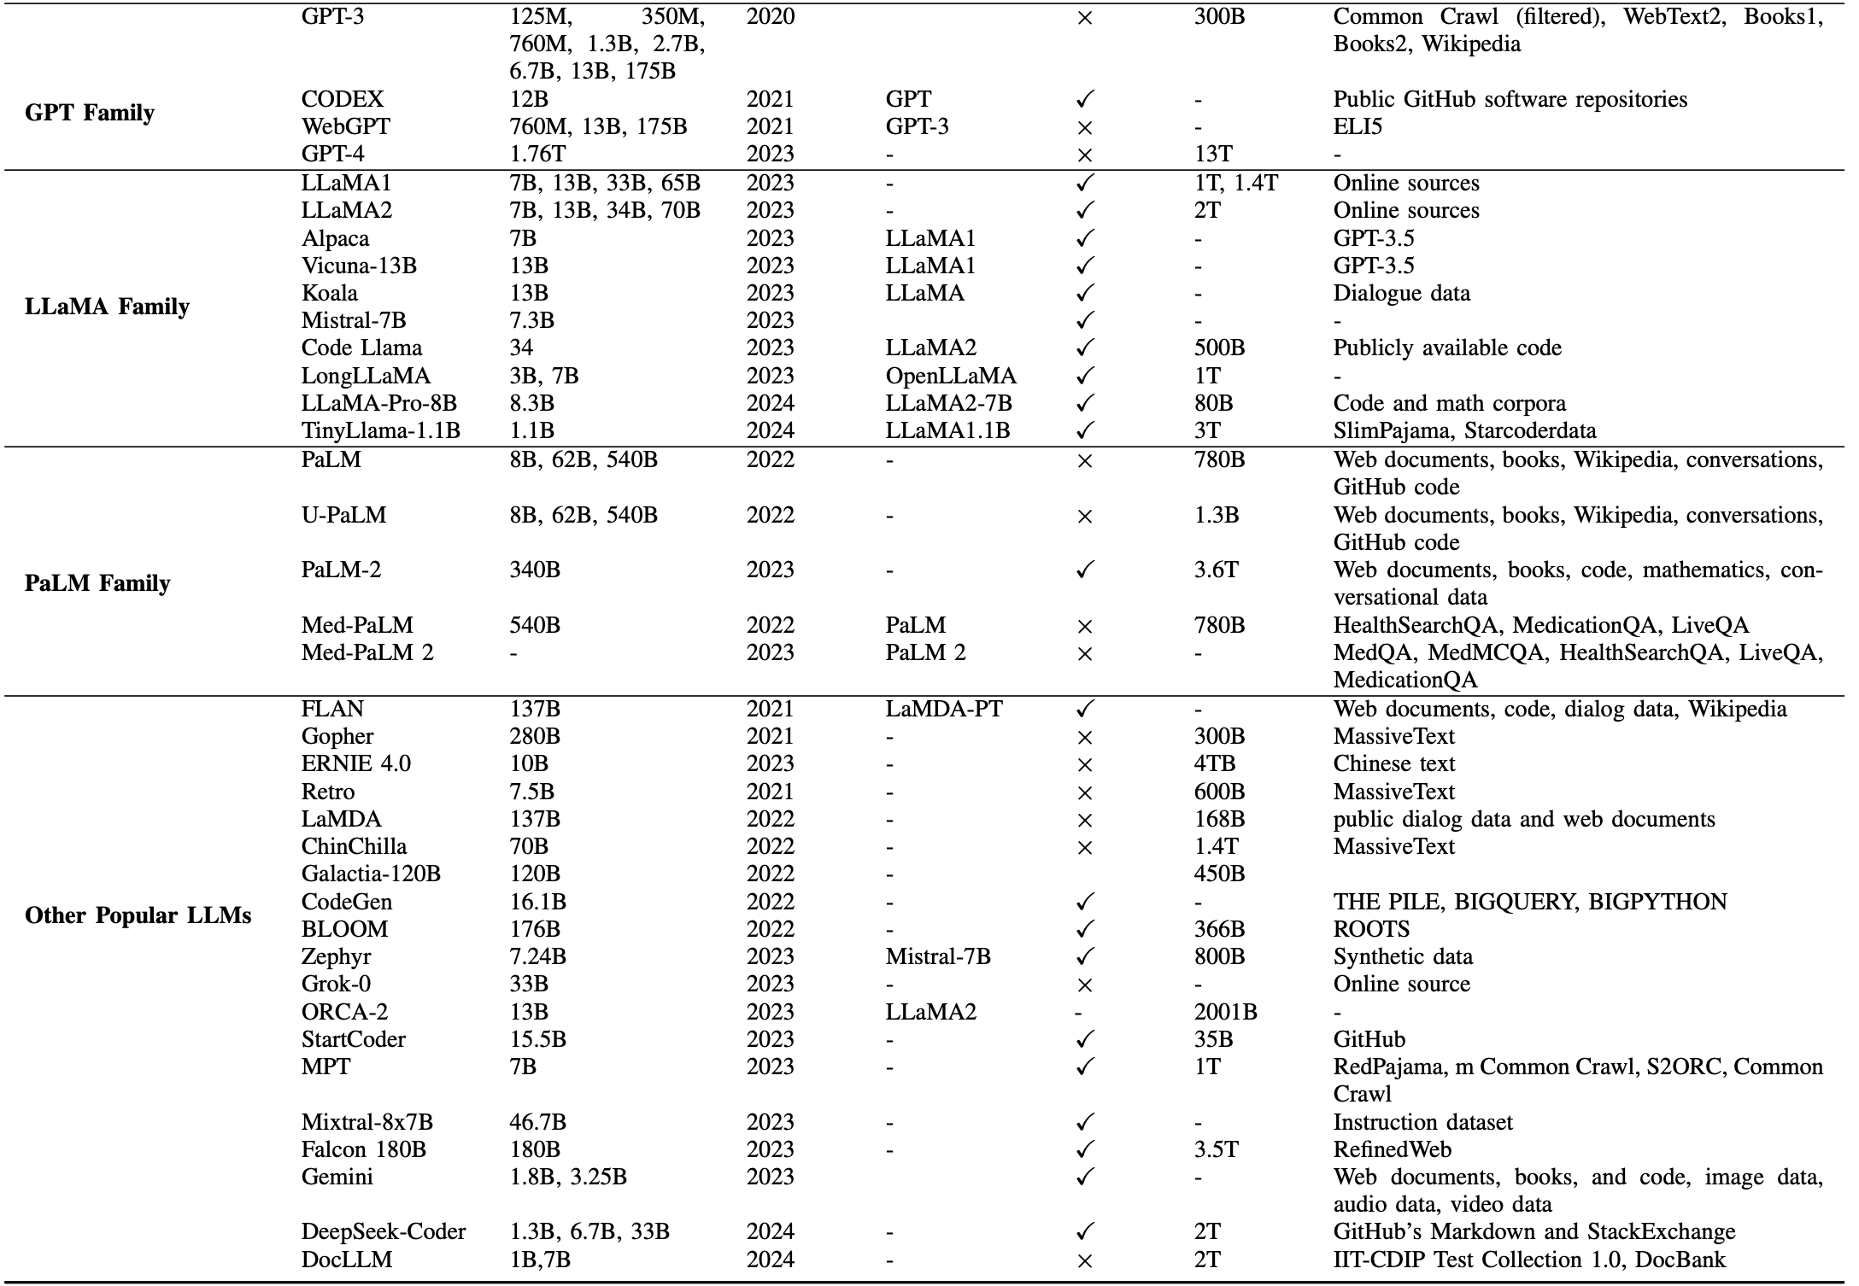
Semantic Detection and Comparison(Table Content)

Slide 37
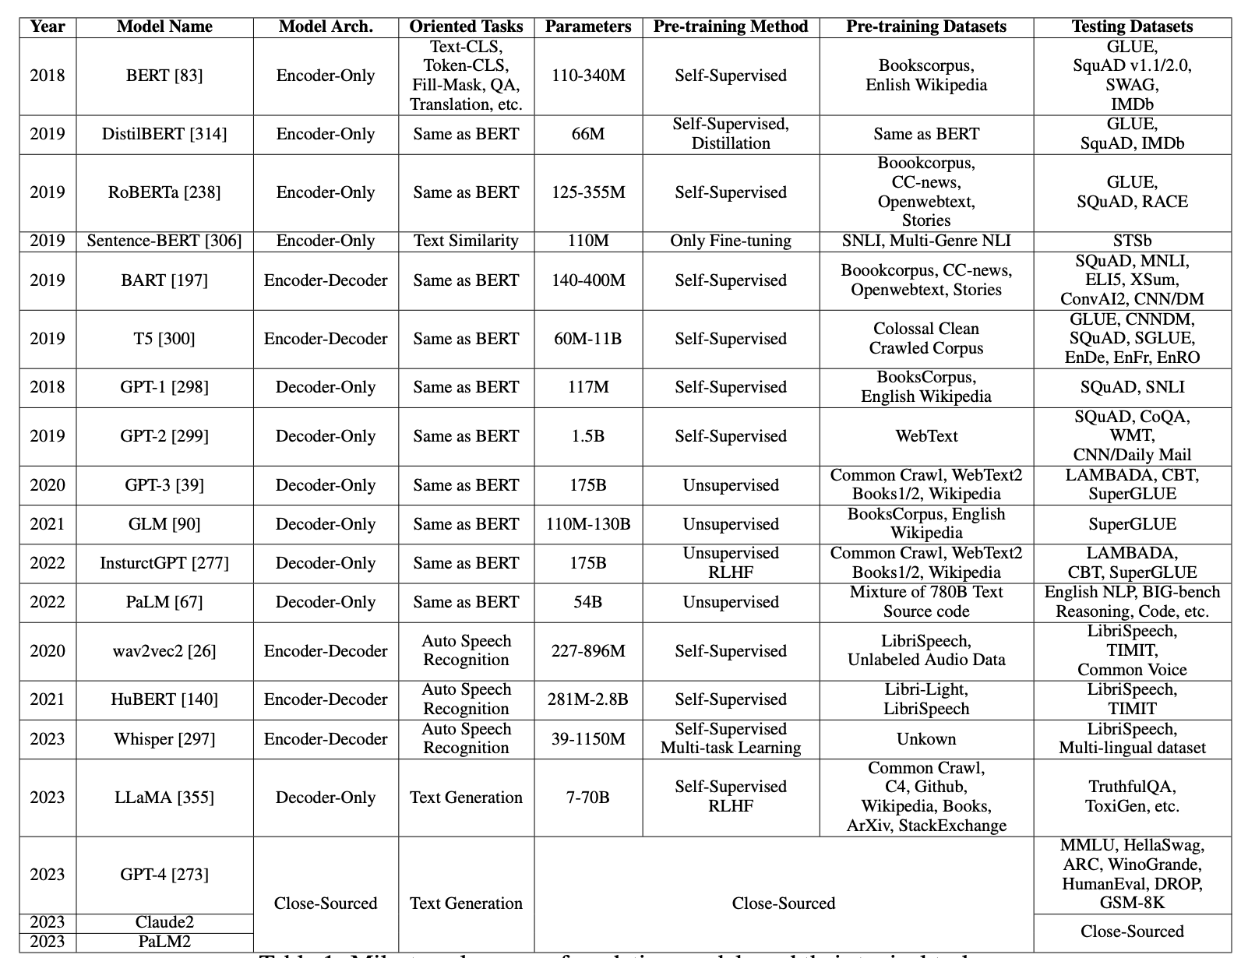

Slide 38
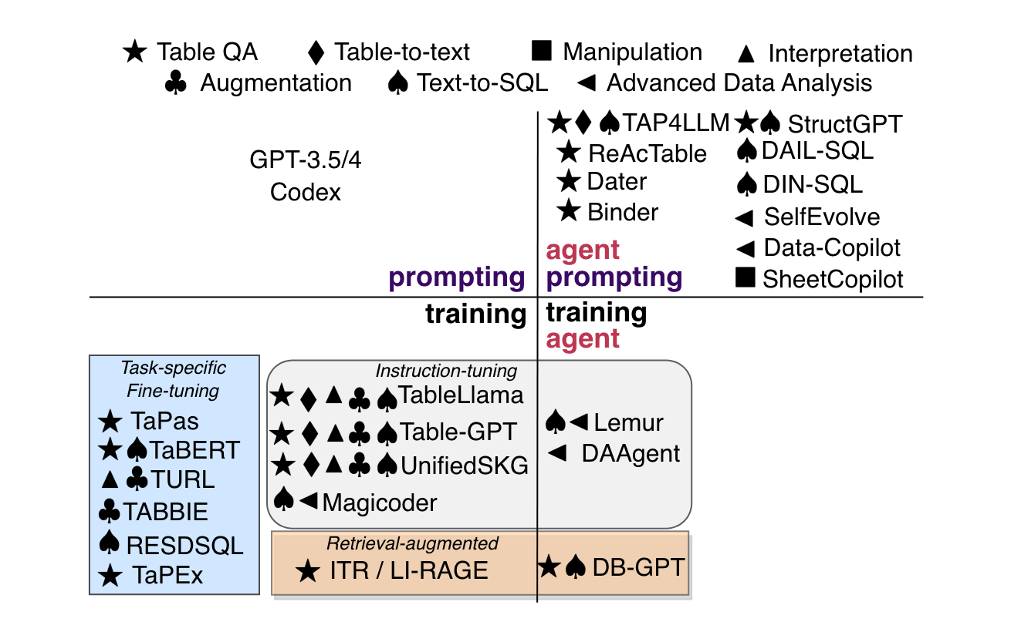
Taxonomy of LLM-based table methods

